Slide 1
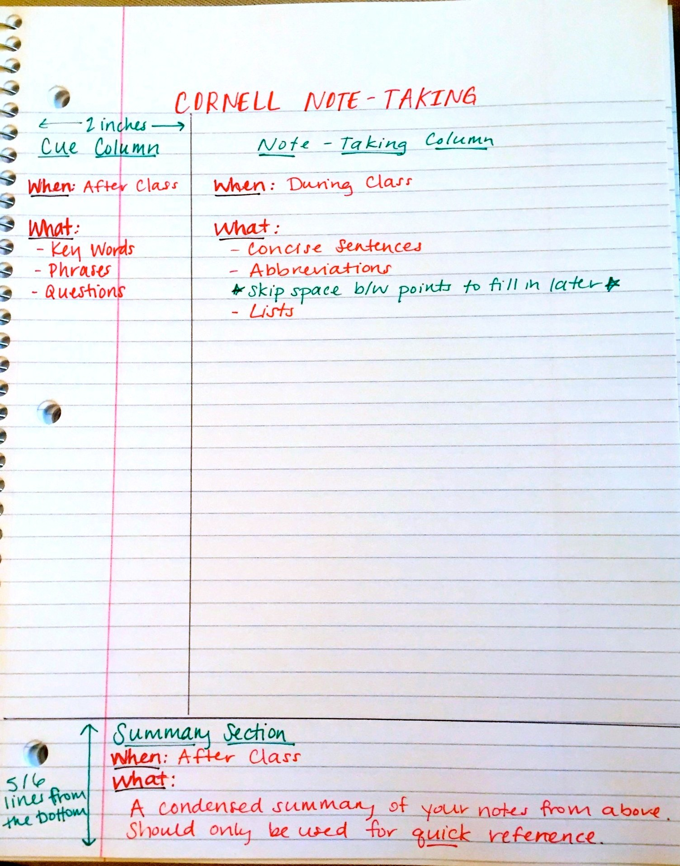
Rule up your page so it is in a Cornell Notes style.
Rule up about 5cm from the left of the page
Rule up about 5-6 lines from the bottom
The left column is our “Key Terms”, the right is our “Notes”, and the bottom is our “Summary”.

Slide 2
What is Science?
Success Criteria
I can define ‘science’.
I can explain how science is performed.
I can describe how science and technology impacts our lives.

Slide 3

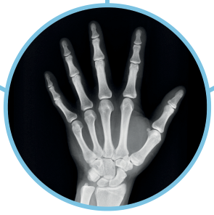

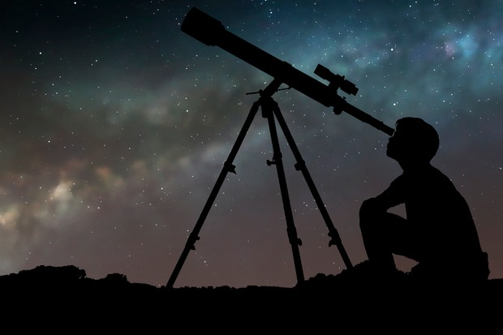
What is Science?
Think – Pair – Share
What is Science?
Think about your answer quietly
When instructed, share with a partner
When asked, share with the class.

Slide 4
What is Science?

Slide 5
What is Science?
Science is more than just a list of facts. Science is something we do. It is how we learn about the world around us.
Science is a process of observing what is happening, asking questions and trying to explain observations. We perform experiments to gather evidence and test our explanations.
The more evidence we have, the more sure we can be about our explanations. But science never stops! If new evidence doesn’t match our explanations then we need to change the explanation.

Slide 6
What is Science?
Make an observation
Create a theory to explain the observation
Make a prediction on what will happen
Perform an experiment to test the prediction
Experiment result matches the prediction
Experiment result does not match the prediction
The theory might be correct.
The theory is wrong and must be changed.

Slide 7
What is Science?
Observation
Theory
Prediction
This book falls down when dropped.
Objects like being next to the ground and will always fall down.
When I drop this box, it will fall down.
Experiment
I will drop this box and see how it moves.
Experiment result matches the prediction
Great! My theory might be correct. Let’s keep experimenting.

Slide 8
What is Science?
Observation
Theory
Prediction
This book and pen fall down when dropped.
Objects like being next to the ground and will always fall down.
When I drop this balloon, it will fall down.
Experiment
I will drop this balloon and see how it moves.
Experiment result does not match the prediction
The theory is wrong and must be changed.

Slide 9
What is Science?
Observation
Theory
Prediction
The book and box fall down when dropped. The balloon doesn’t.
Square objects like being next to the ground and will always fall down. Round objects float up.
When I drop this ball, it will float.
Experiment
I will drop this ball and observe how it moves.
Experiment result does not match the prediction
The theory is wrong and must be changed.

Slide 10

Why do we learn Science?
Questions:
Why do people do science?
How has science impacted weather forecasts?

Slide 11

Science in our everyday lives
It's easy to take technology for granted in our daily lives. But all of the things we rely on – from cars and computers to medicines and air conditioning – were made possible by scientific discoveries.
Question
What are some things that you have in your life thanks to science and technology?
3 minutes

Slide 12
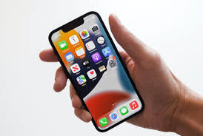
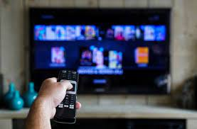
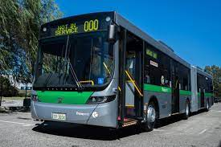
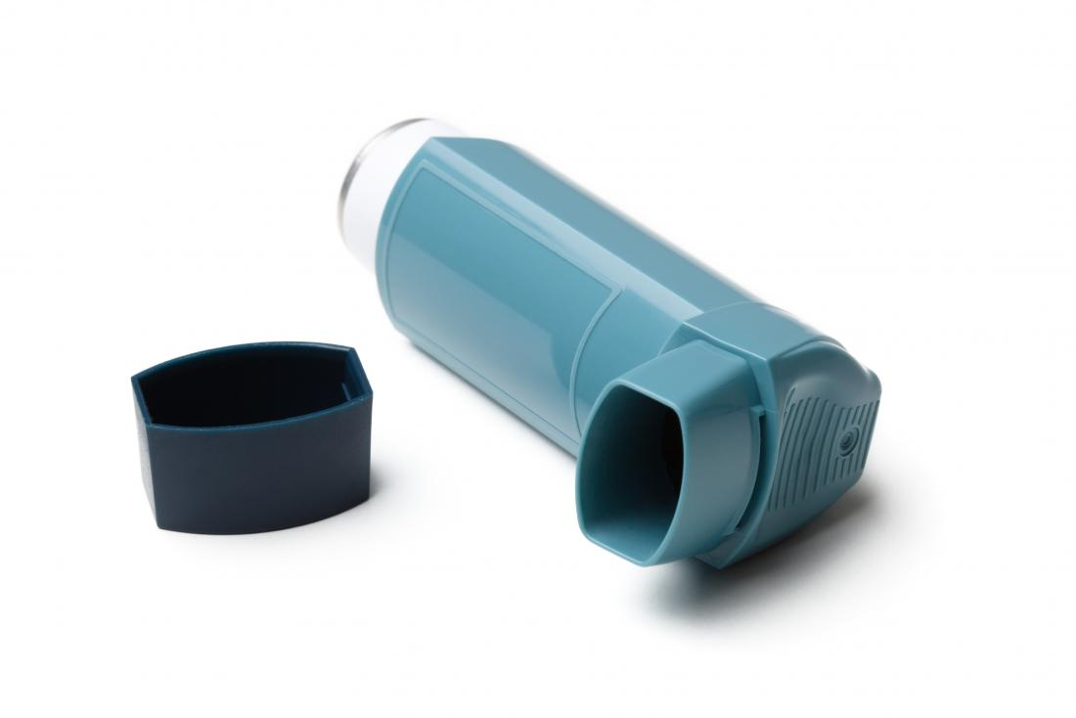
Science in our everyday lives
Question
What are some things that you have in your life thanks to science and technology?

Slide 13
Science answers questions about the world
Scientists try to answer questions about the world to uncover more knowledge and to solve problems that we have.
Questions like:
How can we cure cancer?
What causes gravity?
How can we build a faster plane?
How do we stop climate change?
Question
What are some questions that you have about the world?
3 minutes

Slide 14
Who does Science?
We are going to watch some videos about young scientists. In your books, you will answer the following questions for each video.
Question 1
What is the problem the student wanted to solve?
Describe how it related to their everyday life.
Question 2
Explain how they try to solve their question or problem.

Slide 15

We will explore who does science

Slide 16

We will explore who does science

Slide 17

We will explore who does science

